Slide 1
Deliverable 3

Slide 2

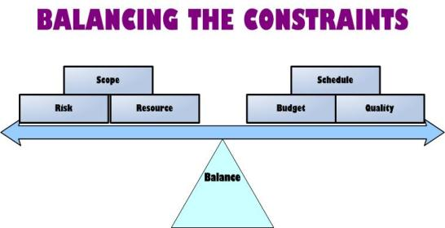
Constraints
“A design decision imposed by environment or a stakeholder that impacts or limits the design.”

Slide 3
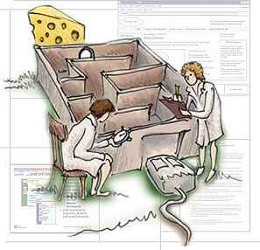

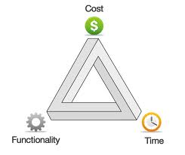
Constraints (continued)

Slide 4


Standards
“A standard or established way of doing things that ensure interoperability.”

Slide 5


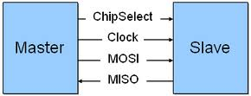
Standards (continued)

Slide 6
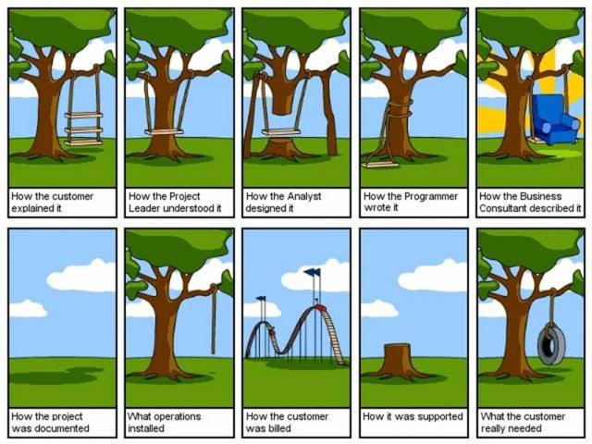
Requirements Specification
“The complete set of all system requirements.”

Slide 7

Requirements Specification (continued)
Photo by Declan McCullagh

